Slide 1
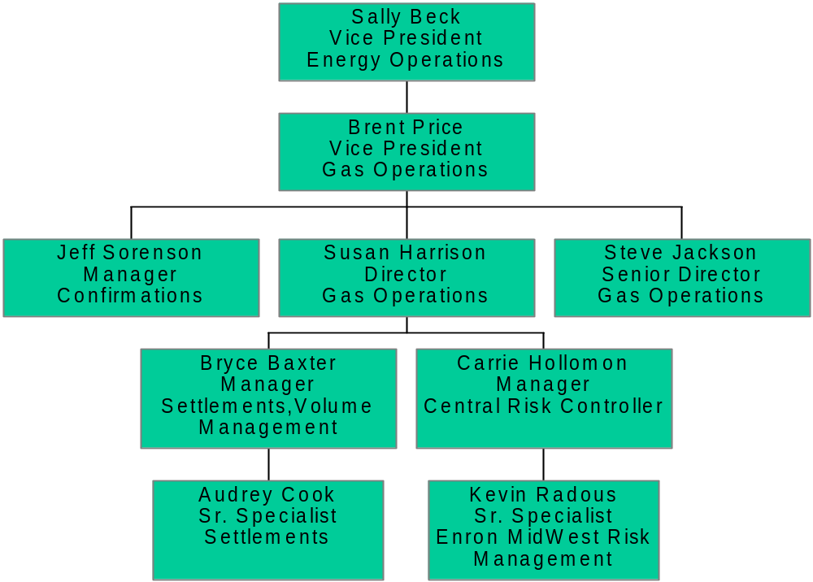
Enron MidWest
Energy Operations Support

